Slide 1

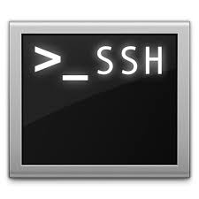

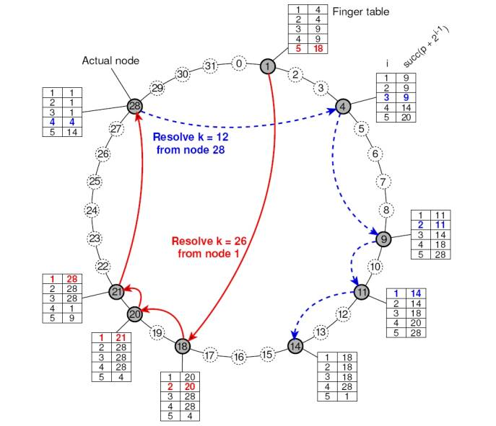
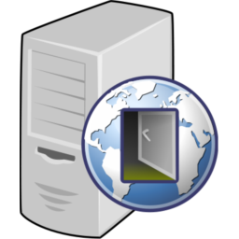
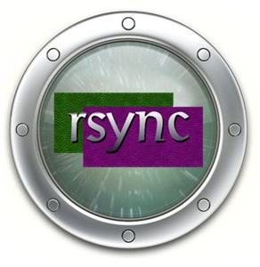
DIAS Implemented Services
Web – Nano and iJetty
Email - JES
SSH
Proxy
P2P
Web
SSH
Email
Peer to Peer
Proxy
Replication

Slide 2

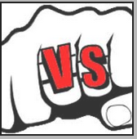
DIAS: Web Server
Serverlet Engine
Support Java EE
Used NIO for I/O
For Large Number but Not Busy Connection
Small Memory Occupation
Flexible
Serverlet Engine
Support Java EE
Used BIO for I/O
For Small Number but Very Busy Connection
Large Memory Occupation
Integration

Slide 3
DIAS: Web Server
Jetty Introduction
A Web server and javax.servlet container, plus support for SPDY, WebSocket, OSGi, JMX, JNDI, JAAS and many other integrations.
These components are open source and available for commercial use and distribution
http://www.eclipse.org/jetty/
Powered
Large clusters
- Yahoo! Hadoop Cluster
Cloud computing
- Google App Engine
SaaS
- Yahoo! Zimbra
Application Servers
- Apache Geronimo
Frameworks
- Google Web Toolkit
Devices
- Android Mobile OS
Eclipse Foundation
A not-for-profit, member supported corporation that hosts the Eclipse projects and helps cultivate both an open source community and an ecosystem of products and services.

Slide 4
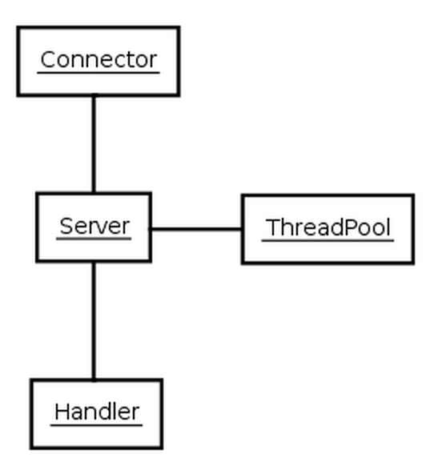
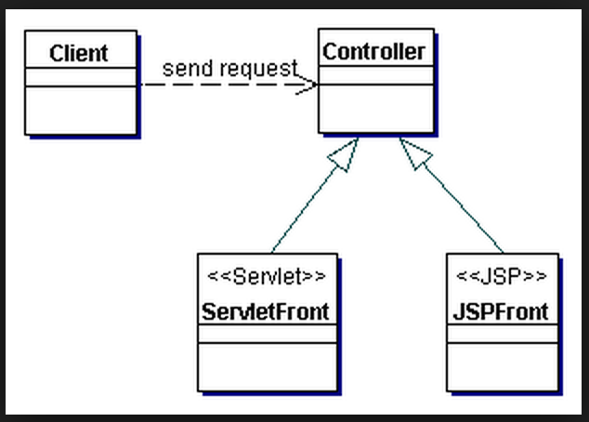
DIAS: Web Server
The Structure of Jetty – View From 20000 Feet
Controller
- Connector
- Client
- Queue
- Thread
View
- JSP Front
- Mobile Phone

Slide 5
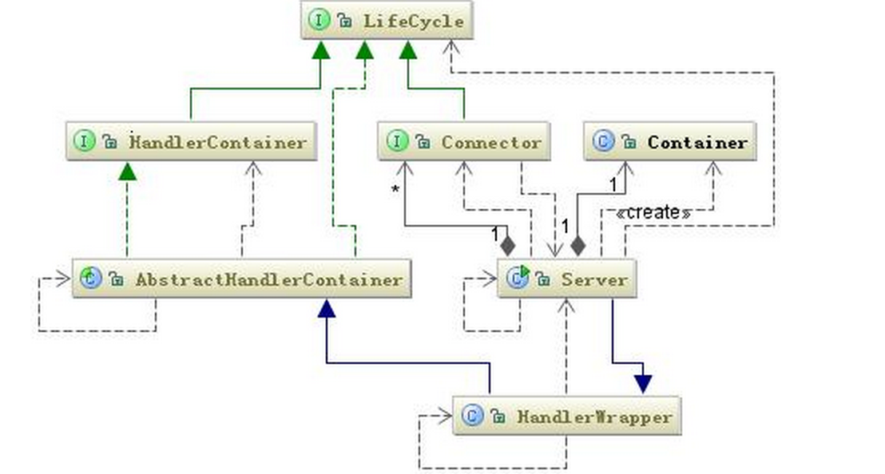
DIAS: Web Server
Model – Handler – Observable Design Patter
Implement Handler
Add Handler
Start Handler

Slide 6
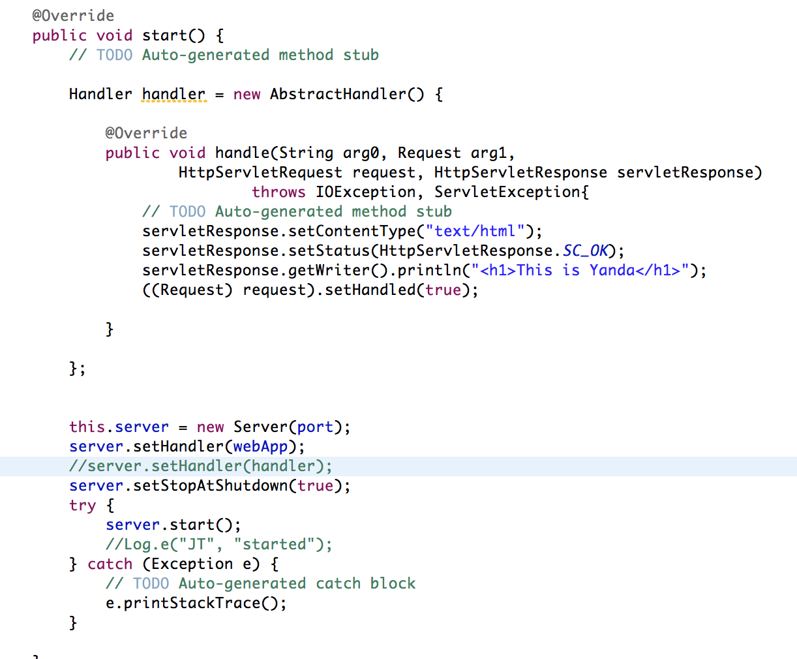
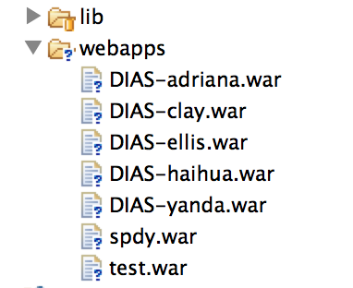
DIAS: Web Server
Embed Start

Slide 7
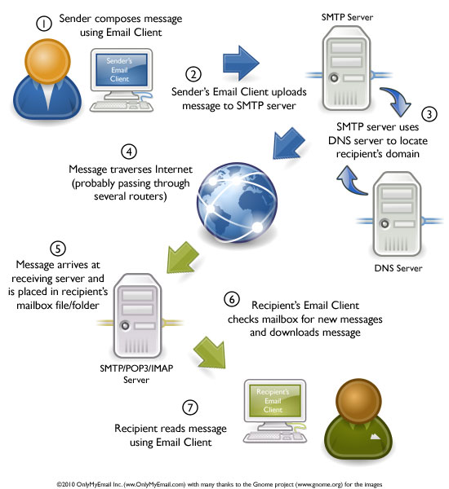
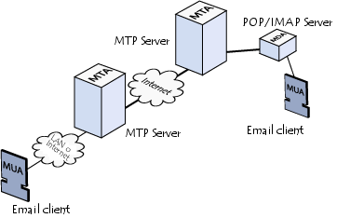
DIAS: Email Server
MTA: Mail Transport Agent
MTAs communicate with one another using the protocol SMTP
MDA: Mail Delivery Agent
POP3 (Post Office Protocol)
IMAP (Internet Message Access Protocol)
MUA: Mail User Agent
Notes:
MTAs tasked with transporting emails
The recipient's MTA then delivers the email to the incoming mail server (called the MDA)
MDA is protected by a user name called a login and by a password.
MTAs act as the post office
the sorting area and mail carrier, which handle message transportation
MDAs act as mailboxes, which store messages (as much as their volume will allow) until the recipients check the box.

